Slide 1
PP2: DNA
Year 10 Science

Slide 2
What is DNA?
Deoxyribonucleic acid
Complex chemical
Found in most cells
Contains information to make you – sort of like a recipe,
or set of chemical instructions
Inherited from your parents
Everyone’s DNA is unique
(with the exception of identical twins)

Slide 3
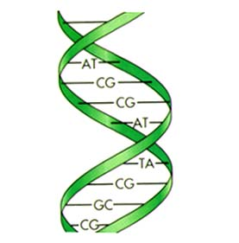
Structure of DNA
Twisted ladder
Called a Double helix
“rungs” made of 4 bases
Cytosine (C)
Guanine (G)
Thymine (T)
Adenosine (A)

Slide 4
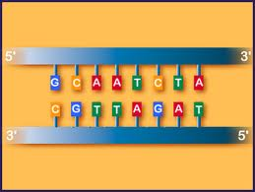
Base Pairing rule
C always pairs with G
T always pairs with A
(and the other way around G-C, A-T)

Slide 5

DNA
Deoxyribonucleic acid
Complex chemical – which carries a set of coded instructions
Twisted ladder shape - Double helix
Rungs of ladder made of 4 bases G,T,A,C
Base pairing rule
C always pairs with G
T always pairs with A
(and the other way around G-C, A-T)

Slide 6
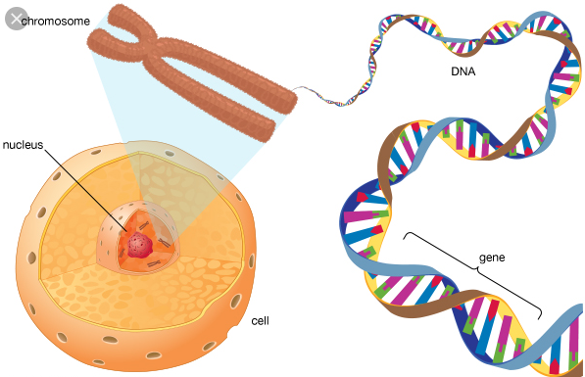
Chromosomes, DNA and genes
Chromosomes in the nucleus are made of tightly wound coils of DNA
A gene is a small length of DNA that codes for a particular characteristic

Slide 7
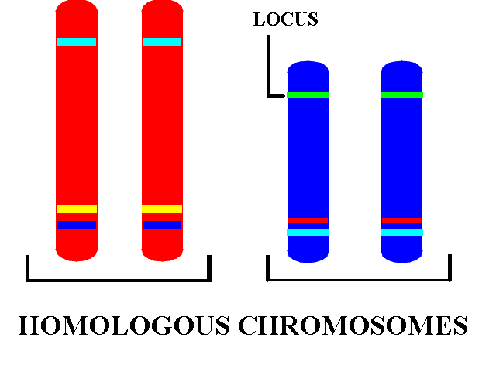
Chromosomes, genes and DNA
Examples of characteristics carried on genes are Eye color, hair color, freckles, nose shape
A gene will always have the same location (called the locus) on a given chromosome
As chromosomes exist in pairs, the genes too exist in pairs – one each from mum and dad
The matching pairs are called homologous chromosomes

Slide 8
Todays Activity
Each student will make a section of DNA out of paper using Origami.
We will join all the sections together and see which class has the longest strand
Instructions for the folding can be found at
http://www.yourgenome.org/activities/origami-dna

Slide 9
Function of DNA
Last lesson we looked at the structure of DNA.
Today we will look at what it actually does – that is its function

Slide 10
Firstly a side step
What are proteins?
They are large very complex molecules necessary for EVERY living organism (animals, plants, fungi and bacteria)
Proteins
make up your bodies structure, Eg muscle fibres, hair, nails, skin elastin and collagen
chemicals such as enzymes and hormones
Genetic traits rely on proteins – eg eye color or if you are lactose intolerant

Slide 11
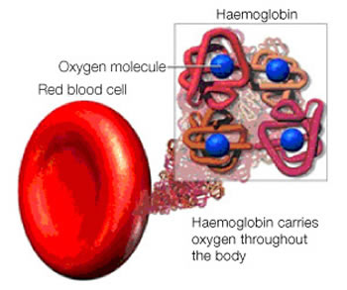
Haemolglobin
A red colored protein that is packed into red blood cells so we can carry oxygen around our body

Slide 12
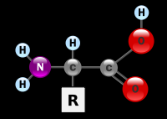
Amino Acids
A smaller molecule also necessary for all living things
Every amino acid has the same structure apart from the R which is different for each one

Slide 13
Where do we get amino acids from?
We either get the amino acids from food, or make them out of other amino acids
We need 20 amino acids to make all the proteins required for life.
Foods rich in protein are we get most of our amino acids – Eg meat, fish, eggs, milk, nuts, seeds and legumes

Slide 14
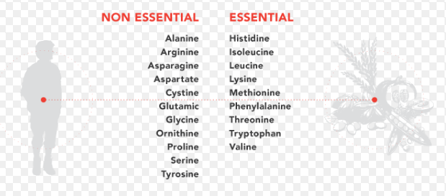
20 Amino Acids

Slide 15
Amino acids and Protein
An amino acid is the building block for PROTEIN,
Many amino acids join together a bit like a beaded necklace to make protein
The necklace is then folded and moulded into a very specific shape
Each protein has a specific function and a specific shape to enable it to perform that function

Slide 16
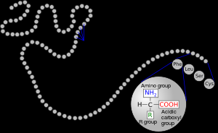

Slide 17
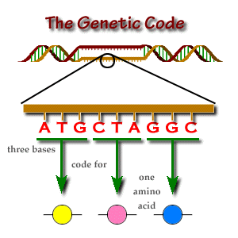
DNA codes for Amino Acids
Look at one side of the DNA ladder
Each three base pairs is called a CODON
Each codon is a code for a specific
AMINO ACID

Slide 18
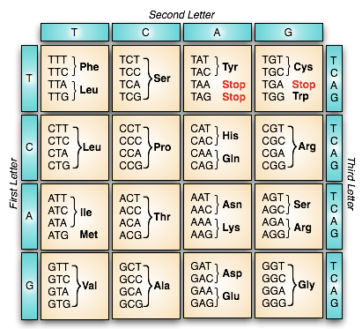
The genetic code

Slide 19
How is the “code”used?
https://www.youtube.com/watch?v=h5mJbP23Buo
(7.71 mins)

Slide 20
Todays Activity
Online – transcribe and translate a gene into a protein
Link on Moodle or here
http://learn.genetics.utah.edu/content/basics/transcribe/

